Slide 1
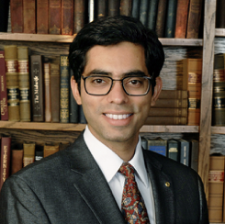

Subactive Techniques for Guaranteeing Routing and Protocol Deadlock Freedom in Interconnection Networks
Mayank Parasar
Ph.D. Defense
School of Electrical and Computer Engineering
Georgia Institute of Technology
mparasar3@gatech.edu

Slide 2
Acknowledgement
Committee Members
Dr. Tushar Krishna, Assistant Professor, ECE, Ph.D. Advisor
Dr. Paul V. Gratz, Associate Professor, ECE, Texas A&M
Dr. Hyesoon Kim, Professor, SCS
Dr. Alexandro Daglis, Assistant Professor, SCS
Dr. Moinuddin Qureshi, Professor, SCS
Collaborators
Dr. Natalie Enright Jerger
Dr. Joshua San Miguel
Dr. Abhishek Bhattacharjee
Dr. Arkaprava Basu
Dr. Michael Wayne LeBeane
Eric Van Tassell
Sooraj Puthoor
Hossein Farrokhbakht
Ankit Sinha

Slide 3
Publications
Deadlock-Freedom
Mayank Parasar, H. Farrokhbakht, N. Enright Jerger, P. Gratz, T. Krishna, and J. San Miguel, “DRAIN: Deadlock Removal for Arbitrary Irregular Networks,” in The 26th IEEE International Symposium on High-Performance Computer Architecture (HPCA), San Diego, California, USA, Feb 2020.
Mayank Parasar, N. Enright Jerger, P. Gratz, J. San Miguel, and T. Krishna, “SWAP: Synchronized Weaving of Adjacent Packets for Network Deadlock Prevention,” in In Proc of 52nd Annual IEEE/ACM International Symposium on Microarchitecture, MICRO-52, 2019.
Mayank Parasar and T. Krishna, “BINDU: Deadlock-freedom with one bubble in the network,” in Proceedings of the Thirteenth IEEE/ACM International Symposium on Networks-on-Chip, NOCS, 2019.
Mayank Parasar, A. Sinha, and T. Krishna, “Brownian Bubble Router: Enabling deadlock freedom via guaranteed forward progress,” in Proceedings of the Twelfth IEEE/ACM International Symposium on Networks-on-Chip, NOCS, 2018
Mayank Parasar, N. Enright Jerger, P. Gratz, J. San Miguel, and T. Krishna, “SEEC: Stochastic Escape Express Channel,” under submission MICRO, 2020
Network Throughput Enhacement
Mayank Parasar and T. Krishna, “Lightweight emulation of virtual channels using swaps,” in Proceedings of the 10th International Workshop on Network on Chip Architectures, NoCArc’17
Virtual Memory (Cache-TLB Co-design)
Mayank Parasar, A. Bhattacharjee, and T. Krishna, “SEESAW: Using superpages to improve VIPT caches,” in 2018 ACM/IEEE 45th Annual International Symposium on Computer Architecture (ISCA), June 2018
Notes:
In interest of time I will talk about Deadlock-freedom…
I would be happy to talk about my other work offline, after my presentation if any one is interested.

Slide 4

Outline
Introduction
Prior Work in Deadlock Freedom
Contribution: Subactive Technique
BBR
BINDU
DRAIN
SWAP
SEEC
DRAGON Tool
Conclusion and Future Work

Slide 5
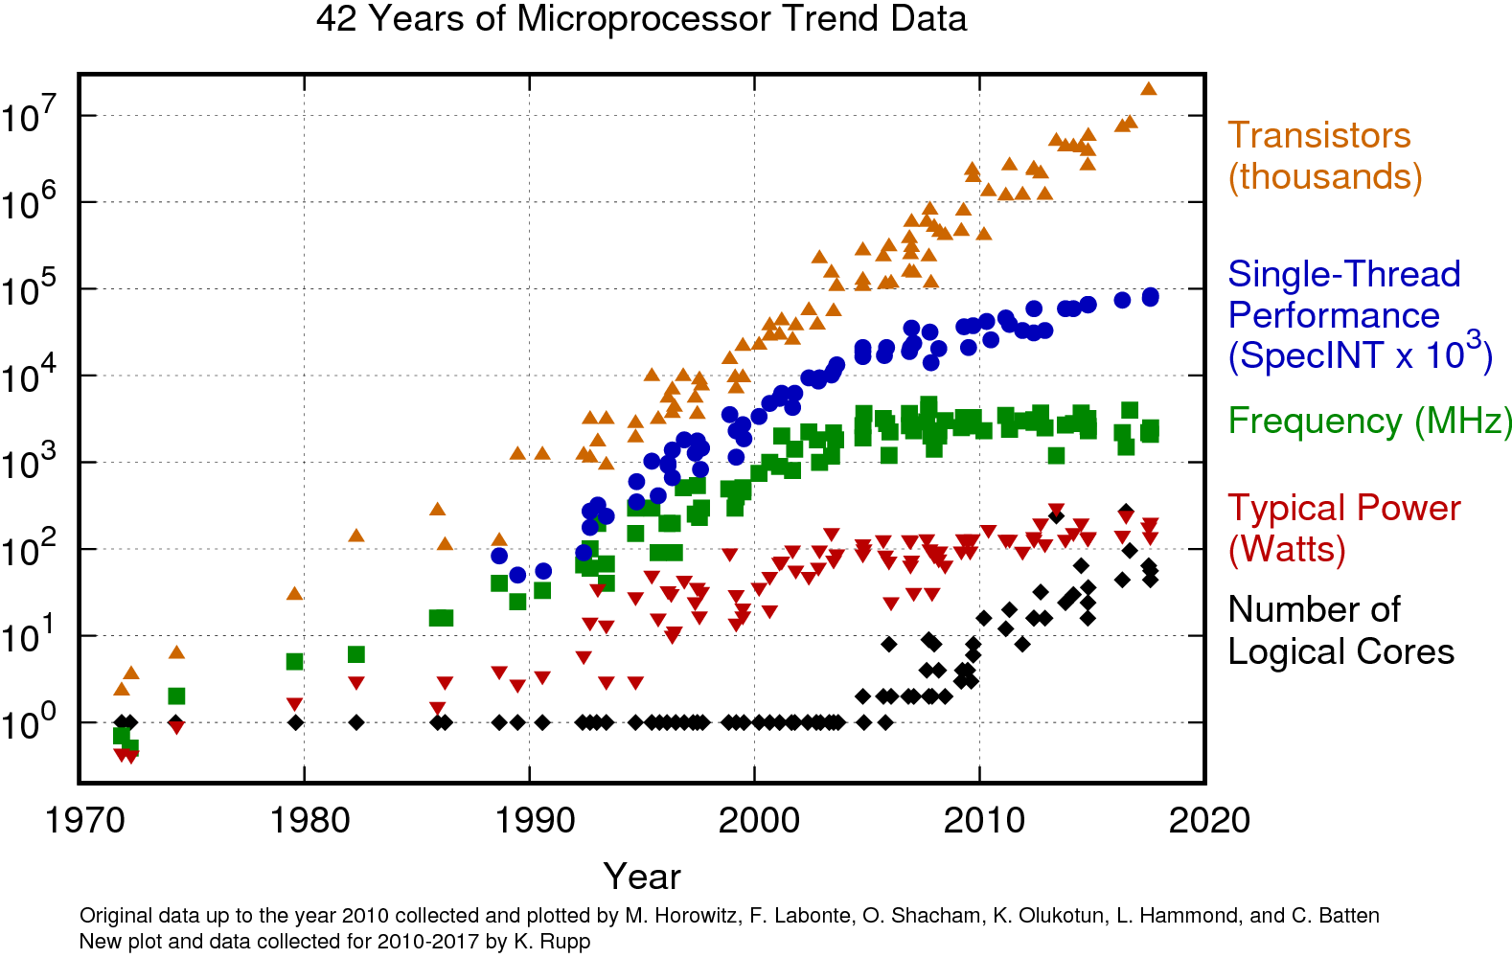
Why study NoCs now?
Interconnection Network takes the center stage

Slide 6
Interconnection Networks

Slide 7
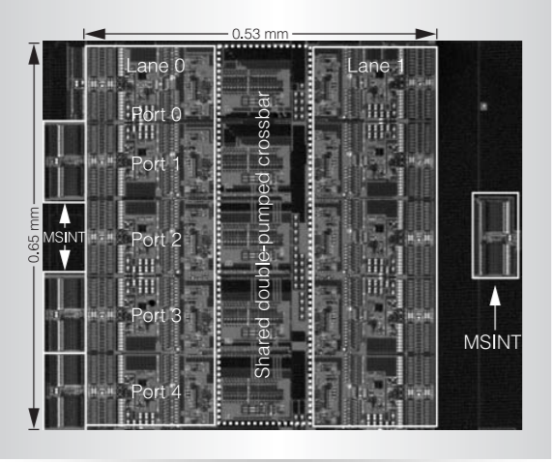
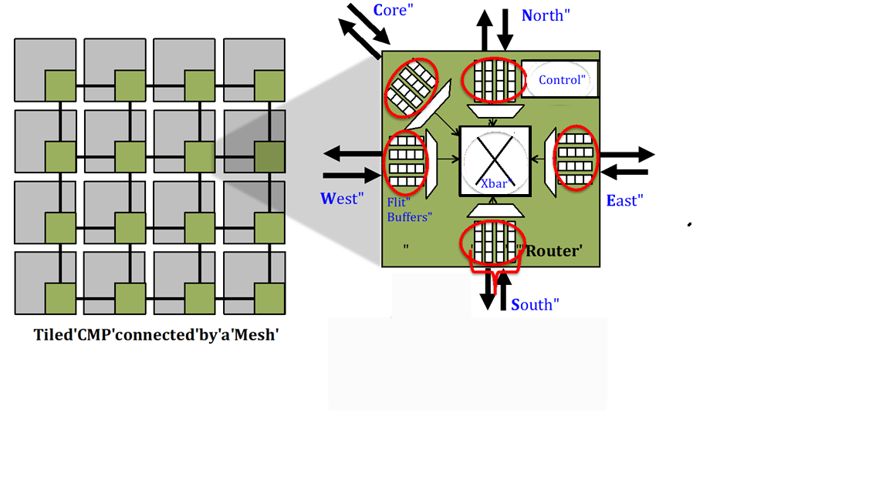
Network on Chip
Core
North
Control
West
Xbar
East
Buffers
Router
South
Router micro-architecture
Source: Intel Teraflops, IEEE Micro 2007
Notes:
After explaining about the importance of interconnection network let me show how interconnection network looks like in a chip.
It is a 4x4 Mesh
Here each tile has its own processor, has a private cache and a slice of Last level cache may be and connected with a router.
The green colored box represents the router.
Let us take a closer look to see how on-chip router looks like.
This is an input buffered Mesh router.
Here packets as they travel the network gets buffered at the input port before moving to next hop router, on its path to destination.
Control logic resolves any conflict if there are 2 or more packets which wants to go out from the same output port. It decides which packet will leave first.
After that packet traverse the X-bar, which connects input ports with output ports.
Packets now leave this router to go to the next hop router using these links. Packet will similarly, then get buffered at the next hop router

Slide 8
Understanding Latency
Injection Rate
Queuing Latency
Network Topology
Network Latency

Slide 9
Network Performance
Saturation Throughput: the injection rate at which
latency ~3x(zero-load latency)
Throughput given by flow control
Network + Queueing Latency
Latency
Throughput given by routing
Zero load latency
(topology+routing+flow control)
Throughput given by topology
Min latency given by routing algorithm
Min latency given by topology
Injection Rate (Packets/node/cycle)

Slide 10
Outline
Introduction
Deadlocks
Prior Work in Deadlock Freedom
Contribution: Subactive Technique
BBR
BINDU
DRAIN
SWAP
SEEC
DRAGON Tool
Conclusion and Future Work

Slide 11
Deadlock: Philosophy
Dining Philosopher Problem

Slide 12
Challenge I: Routing Deadlock
Deadlock: Cyclic dependence between packets
Renders the forward progress of packets impossible
Correctness problem, can cause system failure
Network
6
9
10
5
Network
Deadlock
Network
5
6
10
9
Destination Router-5
Network
5
Notes:
One of the fundamental problem each network must solve is that of deadlock.
Let me show how deadlocks can be manifested in the on-chip network.
this is an arbitrary network topology and we are focusing on these 4 routers where I will show the deadlock using animations.
Packets move in the network to reach their destination and the path is guided by the routing algorithm used in the network.
Packet can only move forward if there is free buffer present at the next hop router in their path towards destination.
Here num on the packet represent the destination router that packet wants to reach.
In doing so they may incur in cyclic dependency as shown here packet 5 cannot move down because the buffer is occupied by packet 6. Packet 6 cannot move right because the buffer is occupied by packet 10 and so on and so forth. This dependency comes back to packet 5. This cyclic dependency leads t a deadlock.
Rendering the forward movement of packet impossible,
And it is a correctness problem which can cause complete system failure.

Slide 13

Challenge II: Protocol Deadlock
Interconnection Network
Finite Network Buffers
Incoming Queue
Outgoing Queue
Interconnection Network can be visualized as queues of buffers transporting packets
Notes:
Second challenge is that of a protocol level deadlock.
To understand protocol level deadlock consider interconnection network to facilitate the movement of packets between nodes.
At a higher level, interconnection network can be considered as queues buffers for transporting packets from their source to destination
Little more animations
Priority inversion.
Protcol assumes that response will not get block…
[animation] two queues ➔ one queue.. Remove left side of the slide
Left side it will not get blocked.. Right one it will get blocked.

Slide 14
Challenge - II: Protocol deadlock
Protocols can deadlock even though network is deadlock-free
Cache 0
Directory
resp
req
req
req
req
resp
req
req
req
req
Responses should always be drained (“consumption assumption”)
Notes:
Animate this slide
But protocols can also deadlock!!

Slide 15
Challenge II: Protocol Deadlock
Cache
Cache
Injection queue
Dedicated Ejection queue
Dedicated queue (aka Virtual Network)
Request Packet
Finite Network Buffers
Response Packet
Directory
Directory
No virtual Network
Separate Virtual Network
Notes:
Explain what is a virtual network
There can be different types of packets flowing in the network. If all types of packet share the same queue then
Higher priority packets may get blocked by lower priority packets as shown in the figure.
Here there is no cyclic dependency, but all the buffers of the network are exhausted by the request packet. This blocks the response packet forever to make forward progress. Response packet needs to reach to its destination for making forward progress of the whole system. This results in protocol level deadlock.
To resolve protocol deadlock separate queue for each message type is allocated, so that packets of one message type do not take up the buffers of other message types. These are called Virtual Network

Slide 16
Buffers in Network
Physical Channels
Virtual Channels
For Correctness
- required
- cannot be shared
VC0
VC1
Protocol Deadlock Avoidance
VC2
“Virtual Networks”
e.g.,
req and resp
Routing Deadlock Avoidance
VC4
.
.
.
For Performance
- not required
- can be shared
HoL blocking
Buffer Turnaround
Multi-flit packets
Link
Router
Notes:
This slide after introduction of virtual network to just show, how much buffering is typically present in the modern routers and our schemes free most of it, providing higher area and power benefits.

Slide 17
Insight: Virtual Networks are underutilized!
VNet-ID →
VNet-ID →
MESI
MOESI
More coherence states to reduce network traversal
Router may need to support more virtual networks
Notes:
These stacked bar-graphs shows the distribution of active and wasted power per virtual network…
Wasted power is XX times more than active power
And specifically more for MOESI protocol compared to MESI protocol.
------ Total number of cycles flits spends at all routers = ((Avg Latency per flit / Avg Hop Count) - 1) * Avg Hop Count * Total Flits Received
U = total number of cycles all the flits spend in all routers / (total sim cycle * total flit buffers) --- and then in this: -----active power should be 0.2*A; 0.6*A; 0.2*A wasted power should be (total power of 1 VNet) - 0.2*A; (total power of 1VNet) - 0.6*A; (total power of 1VNet) - 0.2*A---- A is U*(total power of 3 VNet)
right?

Slide 18

Outline
Introduction
Prior Work in Deadlock Freedom
Proactive
Reactive
Contribution: Subactive Technique
BBR
BINDU
DRAIN
SWAP
SEEC
DRAGON Tool
Conclusion and Future Work

Slide 19
Dealing with Deadlocks
Proactive
Guarantees no deadlocks
Reactive
Detect deadlock and correct

Slide 20
Outline
Introduction
Prior Work in Deadlock Freedom
Proactive
Routing Deadlock
Reactive
Contribution: Subactive Technique
BBR
BINDU
DRAIN
SWAP
SEEC
DRAGON Tool
Conclusion and Future Work

Slide 21
Proactive Techniques
Routing
Turn Restriction
Buffer Assignment
Escape VCs
Flow Control
Control traffic flow such that deadlock does not occur

Slide 22
Proactive Solutions
Removing some turns can make the routing algorithm deadlock free
Pros
Minimal Routing
Cons
Only works for standard (fault-free), regular topologies
XY Model
West-First
Turn Model
Negative-First
Turn Model
1. W. J. Dally and C. L. Seitz, “Deadlock-free message routing in multiprocessor interconnection networks,” IEEE Trans. Computer, May 1987.
2. Christopher J. Glass and Lionel M. Ni. The turn model for adaptive routing. ISCA, May 1992.
3. Daeho Seo, Akif Ali, Won-Taek Lim, Nauman Rafique, and Mithuna Thottenhodi. Near-optimal worst-case throughput routing for two-dimensional mesh networks. ISCA, June 2005.
4. Schroeder, Michael D., et al. “Autonet: a high-speed, self-configuring local area network using point-to-point links” IEEE Journal on Selected Areas in Communications, 1991.
5. Aisopos, Konstantinos, et al. "Ariadne: Agnostic reconfiguration in a disconnected network environment" 2011 PACT. IEEE, 2011.
Notes:
XY – Dimension order routing
WF/NFT: Turn model

Slide 23
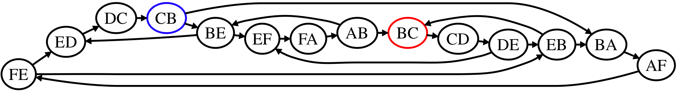
Channel Dependency Graph (CDG)
F
D
E
Cycle
A
C
B
Function of both Topology and Routing Algorithm
Pros
Works for any arbitrary topology
Cons
Introduces non-minimal path and not scalable

Slide 24
Proactive Techniques
Routing
Turn Model in a Mesh
Buffer Assignment
Escape VCs
Flow Control
Control traffic flow such that deadlock does not occur

Slide 25
Proactive solution
Deadlock avoided if cycles eliminated in Channel Dependence Graph
It is possible for a CDG to have cycles and still be deadlock-free [1]
As long as extended CDG is acyclic
Known as the escape path or escape VC
[1] *José Duato. A new theory of deadlock-free adaptive routing in wormhole networks. IEEE Transactions on Parallel and Distributed Systems, December 1993.

Slide 26
Example
Regular VCs
Escape VC
West-first
Acyclic path in extended CDG
Deadlock-free
Notes:
Work on this slide
Because of the restriction and freedom both present simultaneously.. Network is deadlock free.
Uses a fine balance of restriction in packet movement and freedom to provide deadlock free network.

Slide 27
Why escape VCs work?
At least one packet in the cycle has an option to take an acyclic route
If allocation is fair, escape VCs guaranteed to show up eventually
If a message enters the escape network it can move back to the adaptive network, and vice versa, if minimal* routes
*for non-minimal routes, message has to continue on escape VC once it gets in, without going back to the adaptive VCs

Slide 28
Proactive Techniques
Routing
Turn Model in a Mesh
Buffer Assignment
Escape VCs
Flow Control
Control traffic flow such that deadlock does not occur

Slide 29
Bubble Flow Control
Ring Traversal Rule: traverse if one bubble free
BFC Injection Rule:
only inject if 2 bubbles free.
F
E
D
Occupied
Empty
A
B
C
V. Puente et al. The adaptive bubble router. Journal of Parallel and Distributed Computing, 2001.
L. Chen et al., “Critical Bubble Scheme: An Efficient Implementation of Globally Aware Network Flow Control,” IPDPS 2011

Slide 30
Outline
Introduction
Prior Work in Deadlock Freedom
Proactive
Routing Deadlock
Protocol Deadlock
Reactive
Contribution: Subactive Technique
BBR
BINDU
DRAIN
SWAP
SEEC
DRAGON Tool
Conclusion and Future Work

Slide 31
Proactive solution for Protocol Deadlock
Separate set of VCs (called as Virtual Network) for each message class at each input port
Bubble for each message class[1]
[1] Wang, Ruisheng, Lizhong Chen, and Timothy Mark Pinkston. "Bubble coloring: Avoiding routing-and protocol-induced deadlocks with minimal virtual channel requirement." Proceedings of the 27th international ACM conference on International conference on supercomputing. 2013.

Slide 32




Challenges with Proactive Deadlock Freedom
Qualitative Comparison of Deadlock Freedom Mechanisms. P: Proactive, R: Reactive. S: Subactive
Techniques | Full Path Diversity | No Deadlock Detect | No Misroute | No Extra Buffers | Routing deadlock free | Protocol deadlock free
Acyclic CDG (P)
Escape VC (P)
Bubble (P)
Deflection (P)

Slide 33
Outline
Introduction
Prior Work in Deadlock Freedom
Proactive
Reactive
Routing Deadlock
Contribution: Subactive Technique
BBR
BINDU
DRAIN
SWAP
SEEC
DRAGON Tool
Conclusion and Future Work

Slide 34
Insight: Deadlocks are rare!
Number of links removed ➔
0
1
2
4
8
16
20
24
1-vc
blackscholes
4-vc
1-vc
bodytrack
4-vc
canneal
1-vc
4-vc
1-vc
fluidanimate
4-vc
swaptions
1-vc
4-vc
0%
20%
40%
60%
80%
100%
Deadlock Probability
Requires certain ensemble of packets with a particular buffer dependency for the deadlock to occur
Notes:
To quantify the likelihood of routing deadlocks in real application we performed the following experiments
With router configuration of 1-vc and 4-vc per virtual network
We took 8x8 Mesh and progressively removed links to see the likelihood of routing deadlock.
We did not observe the routing level deadlock where there were few faults, Only when the topology becomes fragmented by removing more number od links do we actually start observing the deadlocks.
This shows that deadlocks are rare, yet it is the correctness issue and must be resolved for the functioning of the network.

Slide 35
Dealing with Deadlocks
Proactive
Guarantee that the network will never deadlock
Almost all modern networks use deadlock avoidance
Reactive
Detect deadlock and correct

Slide 36
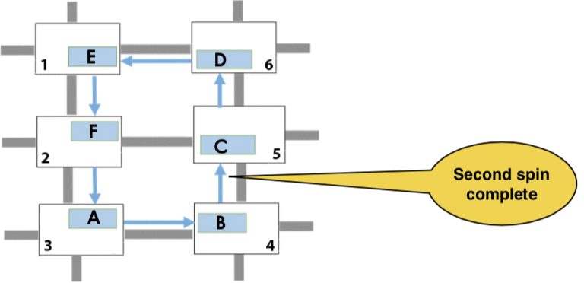
SPIN: Synchronized Progress in Interconnection Networks
First spin
Second spin
Deadlock resolved
A. Ramrakhyani, P. V. Gratz, and T. Krishna, “Synchronized progress in interconnection networks (SPIN) : A new theory for deadlock freedom,” ISCA, 2018.
Notes:
Fix these call-outs
Mention why you have chosen SPIN
“Very recent sate of the art” in reactive solutions

Slide 37
Outline
Introduction
Prior Work in Deadlock Freedom
Proactive
Reactive
Routing Deadlock
Protocol Deadlock
Contribution: Subactive Technique
BBR
BINDU
DRAIN
SWAP
SEEC
DRAGON Tool
Conclusion and Future Work

Slide 38
Reactive Solution for Protocol Deadlock
mDisha
Disha recovery paths include end-point of the networks
Extra buffers for recovery
Detects and maps deadlock using probes at runtime
Resolves deadlock using Disha recovery paths
Yong Ho Song, and T.M. Pinkston “A progressive approach to handling message-dependent deadlock in parallel computer systems”, IEEE Transactions on Parallel and Distributed Systems, 2003

Slide 39
In Summary

Slide 40
Routing Level Deadlock
All turns allowed in green VC
A₃
A₄
A₅
A₃
A₄
A₅
A₄
A₅
A₆
A₂
NO
DEADLOCK
A₆
Synch via
probes
NO DEADLOCK
A₂
A₆
A₃
A₇
No Y to X turns in orange (escape) VC
A₈
A₇
A₁
A₈
A₇
A₂
A₈
A₁
A₁
Proactive Solution
Reactive Solution

Slide 41
Protocol level deadlock
B₄
B₁
B₂
B₃
B₅
B₄
Synch via
probes
B₆
B₁
B₂
B₃
A₁
B₅
NO
DEADLOCK
B₆
A₁
A₄
A₃
A₂
Replies are
not blocked
by requests
A₆
A₅
A₄
A₃
A₂
B₅
B₂
B₃
B₄
Proactive Solution
NO DEADLOCK
B₆
B₁
A₁
A₄
A₃
A₂
Reactive Solution

Slide 42

Qualitative Comparison Table
Qualitative Comparison of Deadlock Freedom Mechanisms. P: Proactive, R: Reactive. S: Subactive
Techniques | Full Path Diversity | No Deadlock Detect | No Misroute | No Extra Buffers | Routing deadlock free | Protocol deadlock free
Acyclic CDG (P)
Escape VC (P)
Bubble (P)
Deflection (P)
Deadlock Buffers (R)
Coordination (R)

Slide 43

Can we design our network…
Is free from routing and protocol level deadlocks?
Does not incur the cost of additional virtual channels irrespective of cache coherence protocol?
High performant?
Full path diversity
Minimal routing
Topology agnostic
Has low area and power requirement at the same time readily implementable?
Notes:
Can ignore this slide./\

Slide 44
Outline
Introduction
Prior Work in Deadlock Freedom
Proactive
Reactive
Contribution: Subactive Technique
BBR
BINDU
DRAIN
SWAP
SEEC
DRAGON Tool
Conclusion and Future Work

Slide 45
Subactive Approach: Thesis Statement
We show periodic coordinated packet movement is sufficient to resolve both routing and protocol deadlocks in any interconnection network

Slide 46
The subactive approach
Subactive Deadlock Freedom
Contribution
Proactive Deadlock Freedom
Reactive Deadlock Freedom
Prior Work

Slide 47
Outline
Introduction
Prior Work in Deadlock Freedom
Proactive
Reactive
Contribution: Subactive Technique
BBR
BINDU
DRAIN
SWAP
SEEC
DRAGON Tool
Conclusion and Future Work

Slide 48
Brownian Bubble Router*: Enabling Deadlock Freedom via Guaranteed Forward Progress
Mayank Parasar, Ankit Sinha and Tushar Krishna
School of Electrical and Computer Engineering
Georgia Institute of Technology
mparasar3@gatech.edu
ankit.Sinha@gatech.edu
tushar@ece.gatech.edu
*Proceedings of the Twelfth IEEE/ACM International Symposium on Networks-on-Chip, NOCS, 2018

Slide 49

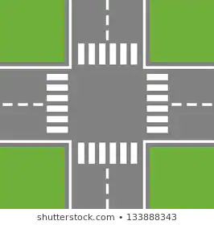
BBR: Brownian Bubble Router [NOCS’18]
What if we keep anyone lane always free to begin with?
collision

Slide 50

BBR: Walk-through
C
Free-VC
C
1
Bubble Movement means reading out packet from its VC and writing it to empty VC marked as ‘Brownian Bubble’
4
3
4
Empty-VC tagged as ‘Brownian-Bubble’
Deadlock
Resolved!
Deadlock!
2
BBR is free from Deadlock-detection complexity!
3
C
C
1
2

Slide 51
Nuance about ‘Brownian Bubble’ movement
It moves randomly across input ports at a fixed rate
BBR-‘k’, refers to the movement of bubble after ‘k’ cycles
BBR will always have one randomly initialized empty VC in the router
Bubble never goes into the injection-input port of the router
Notes:
Reduce the text.

Slide 52
BBR Microarchitecture
BBR moves packets from VCs of one port to VCs of another port
BBR bus for bubble movement
Only 7% area and power overhead
However, number of bubbles reduces the saturation throughput
Scalable to arbitrary topologies

Slide 53
Qualitative Comparison Table
Qualitative Comparison of Deadlock Freedom Mechanisms. P: Proactive, R: Reactive. S: Subactive
Techniques | Full Path Diversity | No Deadlock Detect | No Misroute | No Extra Buffers | Routing deadlock free | Protocol deadlock free
Acyclic CDG (P)
Escape VC (P)
Bubble (P)
Deflection (P)
Deadlock Buffers (R)
Coordination (R)
BBR (S) |  |  | *
However, number of bubbles reduces the saturation throughput

Slide 54
BINDU*: Deadlock-Freedom with One Bubble in the Network
Mayank Parasar, and Tushar Krishna
School of Electrical and Computer Engineering
Georgia Institute of Technology
mparasar3@gatech.edu
tushar@ece.gatech.edu
*Proceedings of the Thirteenth IEEE/ACM International Symposium on Networks-on-Chip, NOCS, 2019

Slide 55
BBR: Brownian Bubble Router [NOCS’18]
What if we keep anyone lane always free to begin with?
collision

Slide 56
BINDU: Bubble in Irregular Network for Deadlock Purging
What if we keep one lane always free in whole road-network to begin with?

Slide 57
BINDU: Walk-through
Bubble (Bindu)
Bindu Path
Bindu Path: Any cyclic path that covers all the input ports of the all the routers in the topology

Slide 58
BINDU: Walk-through
Empty-slot
C
4
Bindu moves in a fixed path visiting all the input ports of the router
It naturally resolves any deadlock that comes in its way by displacing the packets
1
1
2
Deadlock resolved!
Deadlock!
3
2
BINDU is free from Deadlock-detection complexity!
4
3

Slide 59
BINDU Router Microarchitecture
Bindu path is confined to VC-0 of each inport (except injection port) of all the routers in the Network
However, single Bindu might take time to reach deadlock ring as network size increases
Notes:
It has all the benefits of BBR in terms of scalability
But high performant because it has only one bubble/Bindu
Talk about limitation on latency

Slide 60
Qualitative Comparison Table
Qualitative Comparison of Deadlock Freedom Mechanisms. P: Proactive, R: Reactive. S: Subactive
Techniques | Full Path Diversity | No Deadlock Detect | No Misroute | No Extra Buffers | Routing deadlock free | Protocol deadlock free
Acyclic CDG (P)
Escape VC (P)
Bubble (P)
Deflection (P)
Deadlock Buffers (R)
Coordination (R)
BBR (S) |  |  | *
BINDU (S)
However, single bubble present in the network may take time to visit and resolve the deadlock…

Slide 61
SWAP*: Synchronized Weaving of Adjacent Packets for Network Deadlock Resolution
Mayank Parasar, Natalie Enright Jerger, Paul V. Gratz, Joshua San Miguel and Tushar Krishna
mparasar3@gatech.edu
*Proceedings of 52nd Annual IEEE/ACM International Symposium on Microarchitecture, MICRO-52, 2019
Notes:
Hello I am Mayank Parasar from Georgia Tech.
This is a joint work with my advisor Dr. Tushar Krishna and my collaborators Dr. Natalie Jerger from Toronto, Dr. Paul Gratz from Texas A&M and Dr. Josh San Miguel from Wisconsin.
My talk is going to be about a novel technique of providing deadlock freedom by periodically swapping packets in the network.

Slide 62

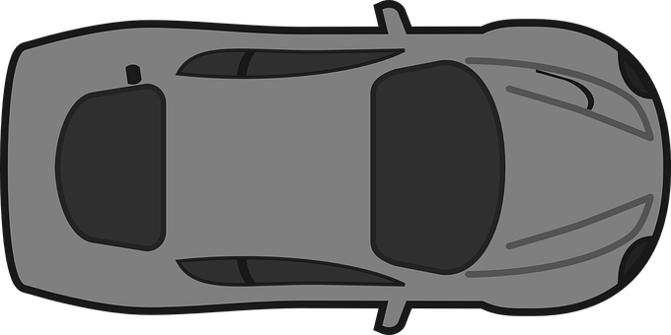
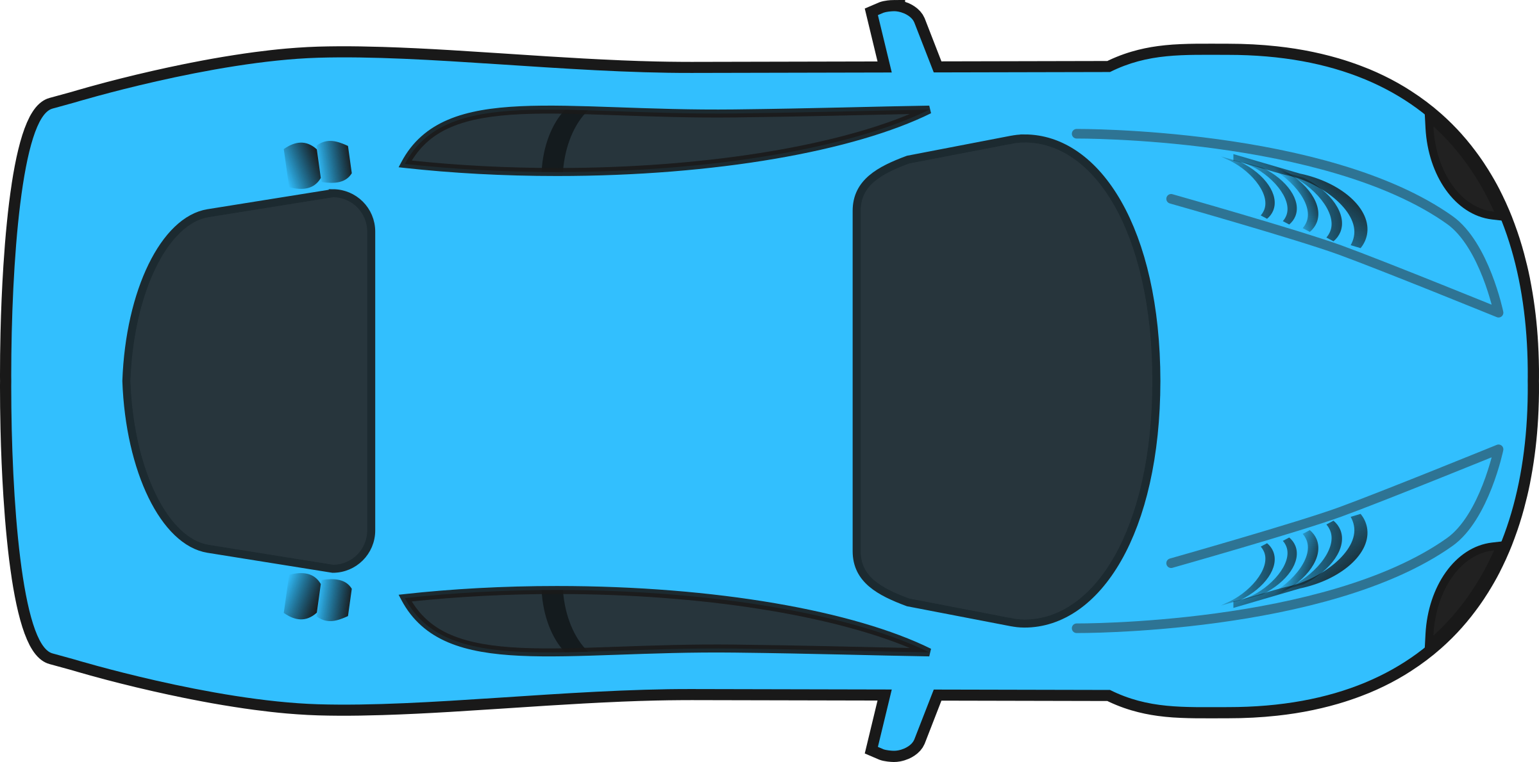
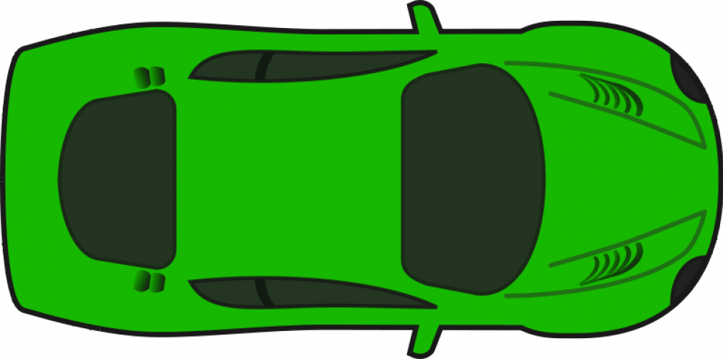
Traffic Deadlock
Deadlock
Notes:
To understand SWAP let us visualize a traffic deadlock
Here each car is waiting on the next car to move in order to make forward progress.
This result in cyclic dependency leading to a traffic deadlock

Slide 63
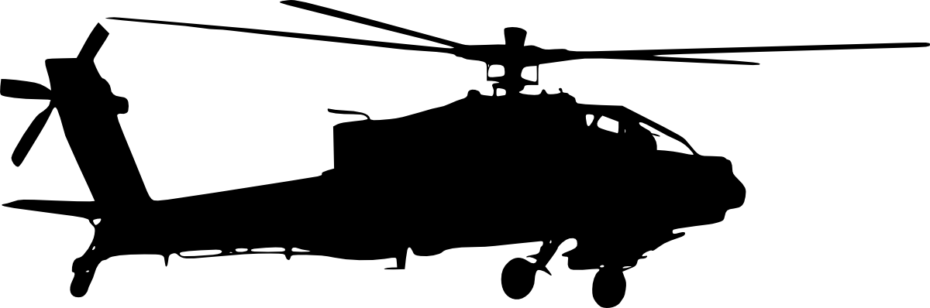
Swap to resolve traffic deadlock
Deadlock
Notes:
Suppose with the help of chopper if we could in-place swap the position of cars then we can resolve traffic deadlock.

Slide 64
Key Terms
‘swapFwd’ packet always makes forward progress
‘swapBack’ packet is interchanged with swapFwd packet in SWAP
‘Backtrack’ is an act where ‘swapBack’ yield its buffer for ‘swapFwd’ to make forward progress

Slide 65
SWAP to resolve Network Deadlock
SWAP
Network
swapFwd
9
10
5
9
Deadlock Resolved!
Network
Deadlock
Network
5
6
6
10
swapBack
Eject
Network
backtrack
Notes:
Similarly as shown before circular dependency of packets can result in traffic deadlock.
If we can in-place swap the packets then we can resolve routing deadlock
Here the packet which makes forward progress is called as swap-forward packet
And the packet which backtrack, by yielding its buffer to be occupied by swap forward packet is called as swapBack packet.
Now packet for destination router 5 has reached its router and will be ejected out from the network.

Slide 66
SWAP
Notes:
Reduce the time spend here

Slide 67
SWAP: Router microarchitecture
Notes:
Skim though it…
In interest of time I am skipping it.. can chat about it later

Slide 68
Qualitative Comparison Table
Qualitative Comparison of Deadlock Freedom Mechanisms. P: Proactive, R: Reactive. S: Subactive
Techniques | Full Path Diversity | No Deadlock Detect | No Misroute | No Extra Buffers | Routing deadlock free | Protocol deadlock free
Acyclic CDG (P)
Escape VC (P)
Bubble (P)
Deflection (P)
Deadlock Buffers (R)
Coordination (R)
BBR (S) |  |  | *
BINDU (S)
SWAP (S)
SWAP can provide routing and protocol level deadlock freedom, however there can be misrouting…

Slide 69
DRAIN*: Deadlock Removal for Arbitrary Irregular Networks
Mayank Parasar, Hossein Farrokhbakht, Natalie Enright Jerger, Paul V. Gratz, Tushar Krishna, Joshua San Miguel
mparasar3@gatech.edu
*Proceedings of 26th IEEE International Symposium on High-Performance Computer Architecture (HPCA) 2020
Notes:
Good morning!
I am Mayank Parasar from Georgia Tech. Today I will talk about a novel technique called DRAIN, which provides deadlock freedom in any network topology by periodically moving packets in the network.

Slide 70



Traffic Deadlock
Oblivious Movement
Deadlock
Notes:
To understand DRAIN, let us consider the traffic deadlock as shown in the figure… Here each car is waiting on the next car to move in order to make forward progress, resulting in traffic deadlock.
If we provide oblivious periodic movement to all the cars in this road network, then this will flush out any deadlock as shown in the animation.
All cars are unblocked and will reach to their destination.
The same idea is used in DRAIN to resolve deadlock, if consider cars as packets and roads as the links in the network

Slide 71
Virtual ring (DRAIN-Path) over topology
0
1
2
5
6
3
4
5
0
3
4
7
6
7
8
1
2
Irregular
Mesh
Every link is spun exactly once, simultaneously
Oblivious packet movement over the virtual ring
Notes:
DRAIN forms a virtual ring over the topology.. As I am showing it for 3x3 Mesh. This is also applicable to other irregular topologies.
The virtual ring is formed such that each link is spun/covered only once, and all the links are covered. This makes sure that there is no collision of packets when spun over this virtual ring
Oblivious packet movement over this virtual ring makes sure that if there is any deadlock in the network, it is flushed out.

Slide 72
DRAIN to resolve Routing Deadlock
Pkt destination
DRAIN Path
Deadlock
Deadlock
Pkt Route
Irregular 3x3 Mesh topology
Notes:
This figure shows how DRAIN resolve routing deadlock in a irregular 3x3 Mesh.

Slide 73
DRAIN to resolve Protocol Deadlock
Response Pkt
Request Pkt
Irregular Mesh
Response Packet Blocked
Protocol Deadlock!
Response Packet is unblocked and reaches its destination
Notes:
This figure shows how DRAIN resolve protocol deadlock in same irregular 3x3 Mesh.

Slide 74
DRAIN: Router microarchitecture
Turn-Table
Epoch register
Credit freeze
Full-Drain Counter
DRAIN is completely decentralized and requires relatively low hardware overhead
Notes:
Fairly low level detail
Decentrallized, relatively low hardware
Keep the image
Don’t drag through
I encourage to read the paper.. I can answer more details

Slide 75
Qualitative Comparison Table
Qualitative Comparison of Deadlock Freedom Mechanisms. P: Proactive, R: Reactive. S: Subactive
Techniques | Full Path Diversity | No Deadlock Detect | No Misroute | No Extra Buffers | Routing deadlock free | Protocol deadlock free
Acyclic CDG (P)
Escape VC (P)
Bubble (P)
Deflection (P)
Deadlock Buffers (R)
Coordination (R)
BBR (S) |  |  | *
BINDU (S)
SWAP (S)
DRAIN (S)
DRAIN can provide routing and protocol level deadlock freedom, however there can be misrouting…

Slide 76
Outline
Introduction
Prior Work in Deadlock Freedom
Proactive
Reactive
Contribution: Subactive Technique
BBR
BINDU
DRAIN
SWAP
SEEC
DRAGON Tool
Conclusion

Slide 77
SEEC: Stochastic Escape Express Channel
Mayank Parasar, Natalie Enright Jerger, Paul V. Gratz, Joshua San Miguel and Tushar Krishna
mparasar3@gatech.edu
Notes:
Good morning!
I am Mayank Parasar from Georgia Tech. Today I will talk about a novel technique called DRAIN, which provides deadlock freedom in any network topology by periodically moving packets in the network.

Slide 78

SEEC: Deadlock Analogy
Deadlock
Destination
Notes:
To understand SWAP let us visualize a traffic deadlock
Here each car is waiting on the next car to move in order to make forward progress.
This result in cyclic dependency leading to a traffic deadlock
Give example of Amazon-Prime which delivers product using drones..

Slide 79


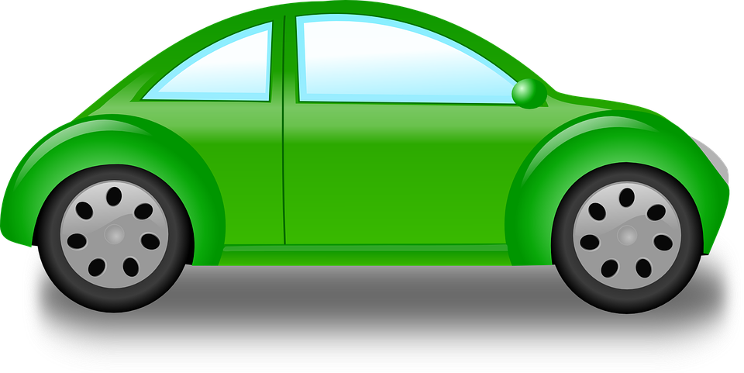
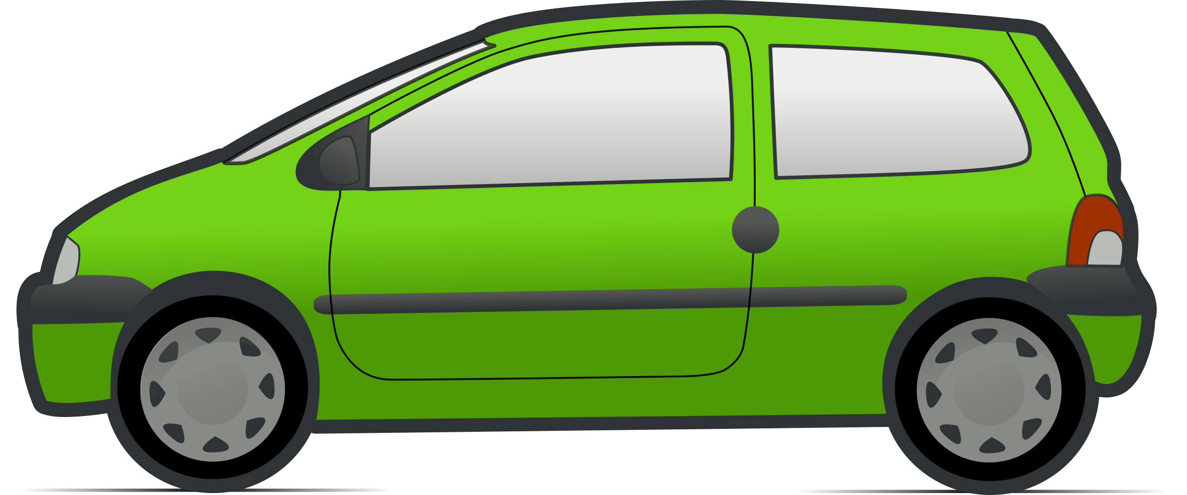


SEEC: Performance Analogy
1
2
3
Destination-1
Destination-2
Destination-3
Notes:
This is to motivate the buffer turn around time.

Slide 80
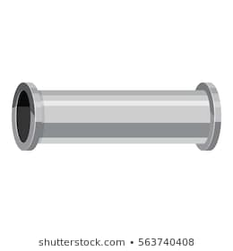
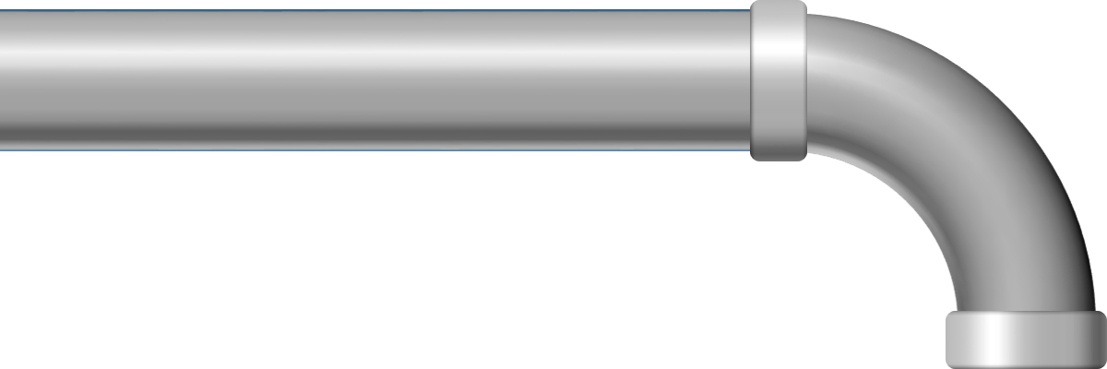

SEEC: Performance Analogy
1
2
3
Destination-1
Destination-2
Destination-3

Slide 81
SEEC: Walk-through (Correctness)
N
12
13
14
15
E
W
S
My turn
Seeker
Static-Round robin order of FF ejection of packets
8
9
10
My turn
11
1
Search Router-10 onwards
8
My turn
Deadlock
Seeker Path
4
7
5
6
7
14
All packets travel minimally
Search Router-5 onwards
0
1
2
3
Seeker
Search Router-9 onwards
1
Seeker
Free Slot
NIC
Notes:
Each router when done with its seeker passing, signals the neighboring router of its turn to send the seeker.. This is done in a round-robin fashion over the network topology.

Slide 82
Definitions
Free Flow (FF)
FF packet
Seeker
Seeker Path
Lookahead
mSEEC
Notes:
Free Flow (FF)
Flow control where packets are not buffered and move forward without need for credit
Seeker
Token sent out by the destination N IC after reserving an ejection VC within a specific message class.
Seeker Path
A side-band network connecting all routers in the network over which the seeker visits all routers, and comes back to its initiator in case it does not find a packet.
FF packet
This packet is chosen by the seeker and traverses to its destination over a minimal path using FF.
Lookahead
Signaling mechanism to support FF packet, so that next router prioritized incoming FF packet
mSEEC

Slide 83
Novel Flow Control: FF Control
FF: Free Flow Control
FF packet gets prioritized over the buffered packets
Packet becomes FF by sending a lookahead signal
lookahead signal sets the appropriate mux at downstream router
FF packet traverse the network from link to link
SEEC proposes co-existence of FF packets and buffered packets

Slide 84
SEEC: Router Microarchitecture

Slide 85
SEEC: Walk-through (Performance)
12
13
14
15
8
9
10
11
SEEC helps packets to bypass congestion in the network
My Turn
1
4
0
5
6
7
0
0
0
Congestion
0
0
0
1
2
3
0
3
0
1
Seeker
NIC
Free Slot

Slide 86
SEEC: Nuances
All packets, buffered and FF, follow minimal routing using network full path diversity
Seeker Path:
Any pre-defined path that visits all router in a cyclic manner
Seeker can follow minimal path to start the search from
Packets are upgraded to follow FF till ejection
FF packet path is decided by the routing algorithm

Slide 87
SEEC: Mathematical upper bound
For any irregular network topology:
Assume diameter is D
Assume it takes on an average ‘k’ cycles at the ejection port
Number of nodes in the network is ‘N’
Let the average network router-radix of the router is ‘r’
The maximum time it takes for a deadlock to persist
Deadlock involves at least 4 routers
[{r*(N-4)*2*D*k} + (D+k)] cycles

Slide 88
Normalized Area and Static Power
~65% Lower Static Area
~70% Lower Static Power
Notes:
Major Area/power savings comes from lower buffer overhead.

Slide 89
Multi-SEEC (mSEEC)
Motivation
Path Diversity: Multiple ways of reaching a node
Link arrangements in topology provide path diversity
Features
Creates multiple FF packets to traverse simultaneously
Requirement
Multiple FF packets traverse minimally wo overlapping paths
Implementation
mSEEC divides the topology into independent regions

Slide 90
mSEEC: Walk Through
Partition
0
1
2
0
1
2
0
1
2
Group-0
A
B
C
A
B
C
A
B
C
D
E
F
D
E
F
D
E
F
G
H
I
G
H
I
G
H
I
When Phase-0 finishes:
each node in group-0 has searched entire topology
Phase-1 starts

Slide 91
mSEEC: Walk Through
Partition
0
1
2
0
1
2
0
1
2
A
B
C
A
B
C
A
B
C
Group-1
D
E
F
D
E
F
D
E
F
G
H
I
G
H
I
G
H
I
When Phase-1 finishes:
each node in group-1 has searched entire topology
Phase-2 starts and so on…

Slide 92
mSEEC
mSEEC provides higher throughput than SEEC
mSEEC achieves this by making multiple FF packets
Each group is a ‘row’ in the Mesh
Each partition is a ‘column’ in the Mesh
As Mesh size increases the path diversity increases
As Mesh size increases more packets can become FF
mSEEC is truly scalable version of SEEC

Slide 93
Deadlock Freedom Proof
The ejection port at NIC has separate Virtual Networks
The response packet can cause a protocol deadlock, if stuck in network
SEEC/mSEEC is protocol deadlock free as NIC will eject response packet by sending seeker as it gets a free-slot
SEEC/mSEEC is routing deadlock free as all the input ports get chance to send packets via FF flow control
SEEC/mSEEC is livelock free as there is no misrouting

Slide 94
Qualitative Comparison Table
Qualitative Comparison of Deadlock Freedom Mechanisms. P: Proactive, R: Reactive. S: Subactive
Techniques | Full Path Diversity | No Deadlock Detect | No Misroute | No Extra Buffers | Routing deadlock free | Protocol deadlock free
Acyclic CDG (P)
Escape VC (P)
Bubble (P)
Deflection (P)
Deadlock Buffers (R)
Coordination (R)
BBR (S) |  |  | *
BINDU (S)
SWAP (S)
DRAIN (S)
SEEC/mSEEC (S)

Slide 95
Results: SEEC-Performance Topology Sweep
11% over subactive techniques
25% over prior work
30% over subactive techniques
40% over prior work
40% over subactive techniques
57% over prior work

Slide 96
Results: SEEC-Throughput Enhancement
Uniform Random
XY Routing
Uniform Random
West First Routing
16% throughput improvement in 4x4 Mesh

Slide 97
Results: SEEC-%age of FF packets

Slide 98
Results: SEEC-Network Latency breakdown

Slide 99
Results: Subactive Techniques
We observe following performance order (subactive techniques only) : BBR < BINDU ≈ DRAIN ≈ SWAP < SEEC < mSEEC

Slide 100
Results: Full System Simulation
mSEEC provides 37% lower packet latency compared to baseline Escape VC in 4x4 Mesh
SEEC/mSEEC use 1/6th of total buffer area

Slide 101
Result: Max Packet Latency
mSEEC has the lowest max packet latency

Slide 102
Outline
Introduction
Prior Work in Deadlock Freedom
Proactive
Reactive
Contribution: Subactive Technique
BBR
BINDU
DRAIN
SWAP
SEEC
DRAGON Tool
Conclusion and Future Work

Slide 103
DRAGON: Deadlock Recognizing Topology Agnostic Network
Mayank Parasar, Natalie Enright Jerger, Paul V. Gratz, Joshua San Miguel and Tushar Krishna
mparasar3@gatech.edu
Notes:
Good morning!
I am Mayank Parasar from Georgia Tech. Today I will talk about a novel technique called DRAIN, which provides deadlock freedom in any network topology by periodically moving packets in the network.

Slide 104
Putting it all together
ITG generates irregular topology as per spec.
RTG creates deadlock-free routing table for irregular Topology
Files generated by ITG and RTG are integrated into DRAGON gem5
DRAGON-gem5 simulates the irr. topology
Deadlock-prone
Deadlock-free (using RTG)
It counts number, shape and size of deadlocks formed at runtime

Slide 105
DRAGON: Walk through
DRAGON snapshot frequency specified by gem5 command-line
3
Blocked Node
6
5
DRAGON takes the snapshot of current network state and create graph
Free Node
1
Node-0_0:
Router-0; Inport-0
4
Node-3_1:
Router-3; Inport-1
3
5
Packet with Destination Router-5
5
4x4 Mesh Topology

Slide 106
DRAGON: First Pass
Blocked Nodes
3
5_2
2_0
8_1
6
5
6_3
1_1
10_1
14_1
1
DRAGON first create a graph with blocked nodes only
Routing Algorithm determines the connection between nodes
4
3
5

Slide 107
DRAGON: Second Pass (DRAGON Graph)
Any blocked node which depends on unblocked node is marked as unblocked recursively in First Pass Graph
At the end of this elimination process only blocked nodes will be present
Number of cycles in the blocked nodes will give us number of routing deadlocks
5_2
2_0
1 deadlock cycle ➔
6_3
1_1

Slide 108
DRAGON Graph
Generic DRAGON Graph to analyze shape, size and number of deadlocks in any network topology

Slide 109
Irregular Topology Generator
Irregular Topology Generator (ITG) automates the generation of irregular topology
Number of faults can be user specified
Number of random topologies can be used specified
Directly integrated to gem5
DRAGON tool + ITG can be used to study:
Number of deadlocks for real applications
Deadlocks Sensitivity in irregular topology for real applications

Slide 110
ITG: Walk though
12
13
14
15
8
9
10
11
Size of topology:
16
Number of links removed:
2
4
4
5
6
7
Number of Irregular Topology:
2
4
0
1
2
3
Currently ITG assumes baseline Mesh topology as the starting point.
This can be modified in the code.
Notes:
Topology is nothing but number of nodes connected in a certain fashion… here we have 16 nodes connected in a way to form ‘Mesh’ topology: Particularly 4x4 Mesh topology
-- Now I will show with the help of animations how ITG tool works
User required to provide these three parameters: ‘size of topology’, ‘number of faults’ and

Slide 111

RTG: Walk though
root
sender
Schroeder, Michael D., et al. “Autonet: a high-speed, self-configuring local area network using point-to-point links” IEEE Journal on Selected Areas in Communications, 1991.
Aisopos, Konstantinos, et al. "Ariadne: Agnostic reconfiguration in a disconnected network environment" 2011 PACT. IEEE, 2011.
0
1
2
3
dn
dn
dn
4
5
6
7
dn
receiver
8
9
10
11
12
13
14
15

Slide 112
RTG: Walk though
root
sender
0
1
2
DN->UP not allowed by routing algorithm
3
dn
up
4
5
6
7
receiver
8
9
10
11
12
13
14
15
Notes:
Non-minimal paths in certain cases

Slide 113
RTG: Walk though
root
sender
up
up
0
1
2
DN->UP not allowed by routing algorithm
3
dn
dn
dn
up
4
5
6
7
receiver
8
9
10
11
12
13
14
15

Slide 114
Deadlock Probability: Topology Sweep

Slide 115
Deadlock Probability: Traffic Pattern Sweep

Slide 116
Synthetic Traffic: Throughput

Slide 117
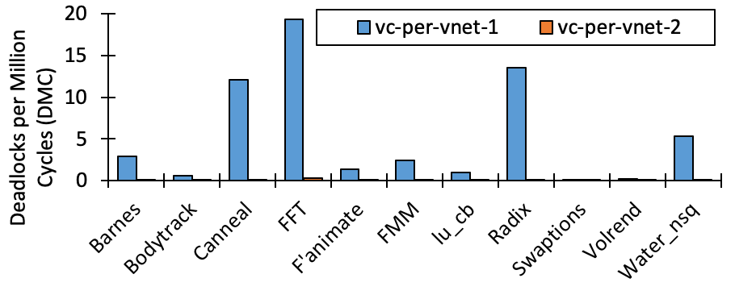
Full System Results
Done on 4x4 Mesh, using Parsec3.0 with full-system
FFT shows maximum DMC
Drastic decrease in DMC with increase in VCs/input port

Slide 118
Outline
Introduction
Prior Work in Deadlock Freedom
Proactive
Reactive
Contribution: Subactive Technique
BBR
BINDU
DRAIN
SWAP
SEEC
DRAGON Tool
Conclusion and Future Work

Slide 119
Conclusion
The Subactive Techniques

Slide 120
Conclusion: The Subactive techniques
Deadlock is a condition which every network needs to solve
Deadlock occurs at various levels
Routing Deadlocks
Protocol Deadlocks
Current solutions either provide extra buffers, or restrict turns, or require expensive detection circuitry
Subactive techniques provide a unified approach to resolve routing and protocol level deadlocks:
Do not require extra buffers
Do not restrict turns
Do not require deadlock detection

Slide 121
Future Work

Slide 122
Quality of Service using SWAP
Mayank Parasar, Natalie Enright Jerger, Paul V. Gratz, Joshua San Miguel and Tushar Krishna
mparasar3@gatech.edu
Notes:
Good morning!
I am Mayank Parasar from Georgia Tech. Today I will talk about a novel technique called DRAIN, which provides deadlock freedom in any network topology by periodically moving packets in the network.

Slide 123
Future Work: Quality of Service in Network
‘Swap’ also provide hard- guarantees for Quality of Service.
Create levels of priority among packets in the network
Only high priority packet can swap a low priority packet

Slide 124
Quality of Service in Network : Walk-through
High Priority Packet (HPP)
Cycle
1
swap
swap
Path to destination
2
3
4
5
6
swap
Low Priority Packet (LPP)
Destination of HPP
High priority packet can SWAP low priority packet but not vice-versa

Slide 125
Thank you!

